Slide 1

Book-Store Inventory System
Presented By
Shahabaz Bagwan & Shubham Nalawade

Slide 2
Introduction
Bookstore is the place where the people will be able to get the books of their choice at reasonable price.
There can be various kinds of books available at the book store. But if it is the giant bookstore then the management of it will be very difficult.
The software system being produced is called Book Store Inventory System.
It is being produced for a maintaining inventory details of books in bookstore via the Internet.
The Book Store Inventory System will allow admin user to add Book Store Manager and also it will allow Manager to manage Inventory.
The system also allows a manager to manage the inventory with full create, retrieve, update and delete functionality with regards to books in the system.

Slide 3
Technology Used
Spring-Boot :–
The main goal of the Spring Boot framework is to reduce overall development time and increase efficiency. React has become the first choice for frontend because it gives developers the ability to work with a virtual browser (more friendly than the real browser). Also, a JavaScript developer can become a productive developer in a few hours because there is a small API to learn, a few functions, and how to use them…
React :–
React allows developers to create large web applications that can change data, without reloading the page. The main purpose of React is to be fast, scalable, and simple. Spring

Slide 4
Technology Used
Database (MySQL) :–
MySQL is a relational database management system that runs as a server providing multi-user access to a number of databases. Various types of databases are offered at NJIT for personal, departmental, research, and other purposes. These databases support a number of APIs, servlet applications, and security protocols.

Slide 5
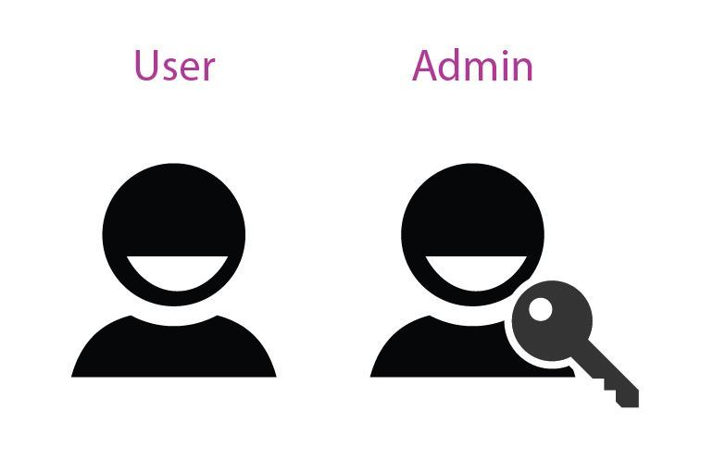

User Classes
Admin
Manager
Manager
In this module admin can manage the book store managers. He/she can add , remove manager and also modify the information related to manager.
In this module manager can manage the book store inventory. He/she can add , remove books from inventory and also modify the information related to books.

Slide 6
Product Functions
The system provides efficient way to manage the book-store inventory.
The system provides easy interface that users can easily access system.
System provides better ways for managing the managers working in book-store and also managing the inventory of book store.
This System also Comprises of updating information related to book-store manager and also updating information related to books in the inventory.

Slide 7
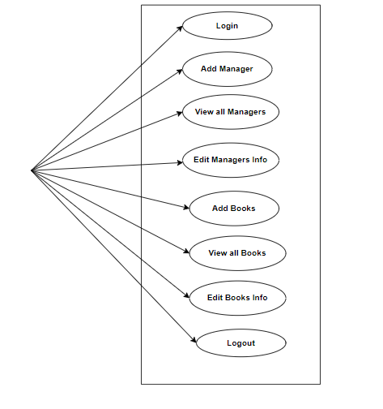
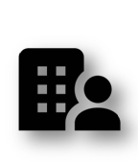
Use Case Diagram of
Book-Store Inventory System

Slide 8
Admin Module :
Admin can
He/she can see the list of all managers working in book-store.
Manages the managers working in the book-store.
He/she can modify the information related to manager.

Slide 9
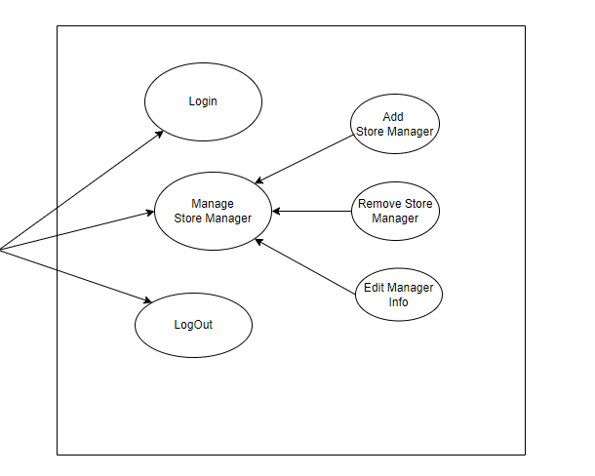
Use case diagram : Admin

Slide 10
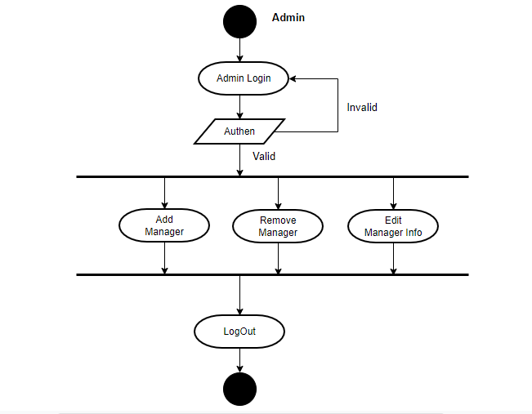
Activity diagram : Admin

Slide 11
Manager Module
Manager can
He/she can see the list of all books present in the book-store inventory.
Manages the inventory of book-store.
He/she can modify the information related to books.

Slide 12
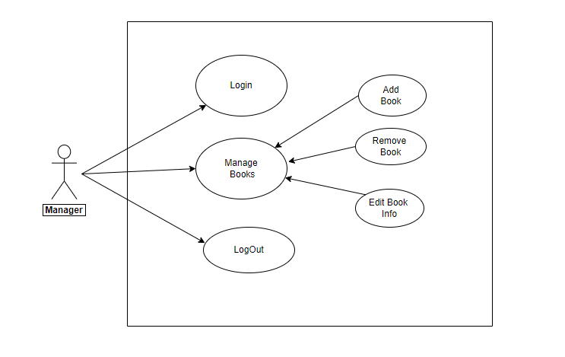

Use case diagram : Manager
Manager

Slide 13
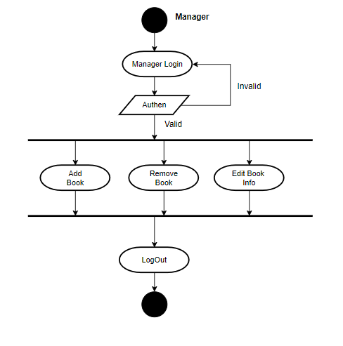
Activity diagram : Manager

Slide 14
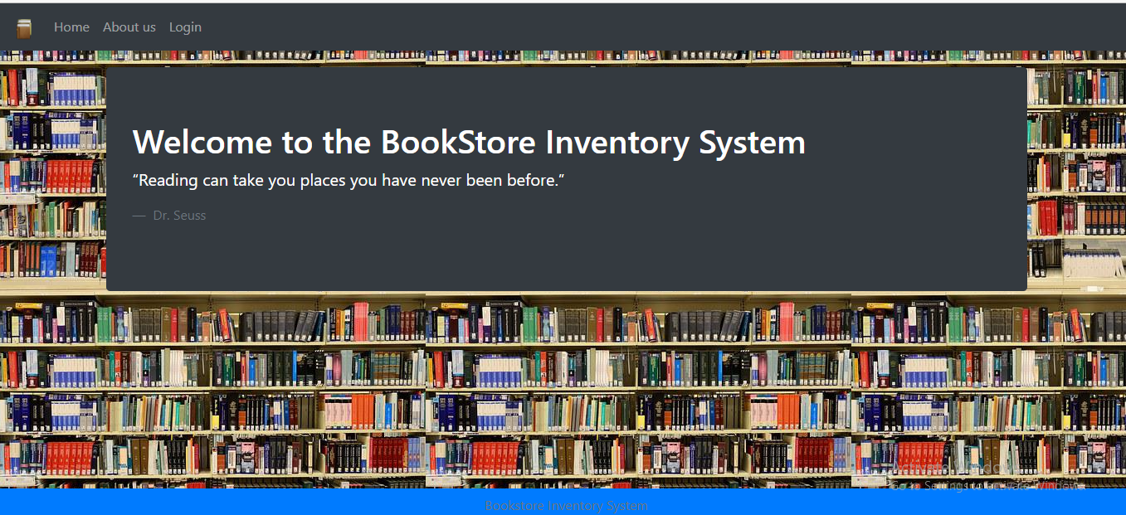
Home Page :

Slide 15
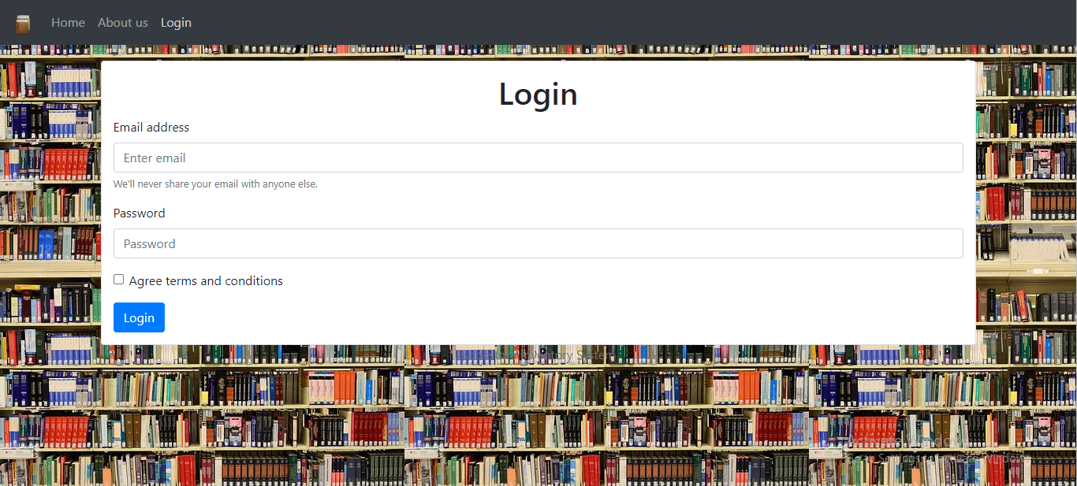
Login Page

Slide 16
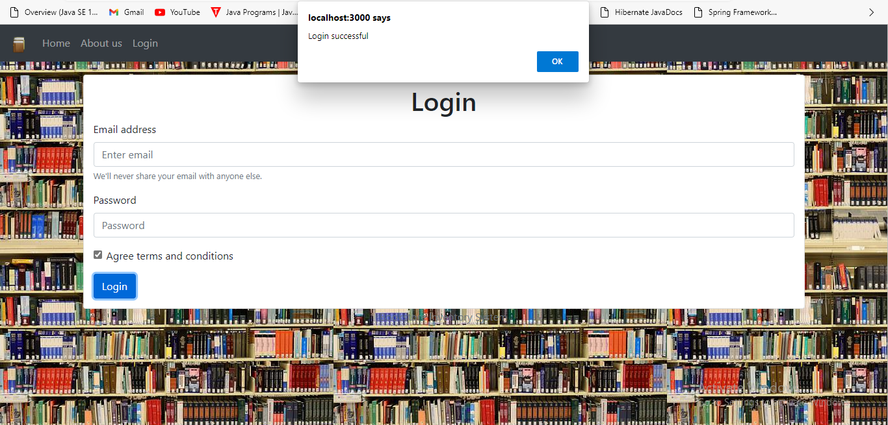
Successfully Login(Admin) :

Slide 17
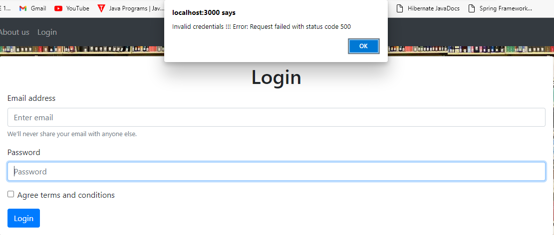
Invalid credentials :

Slide 18
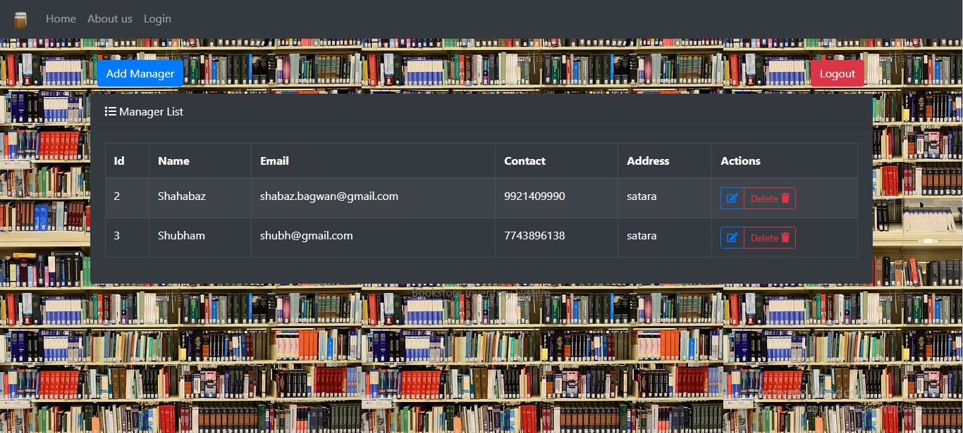
Admin Page

Slide 19
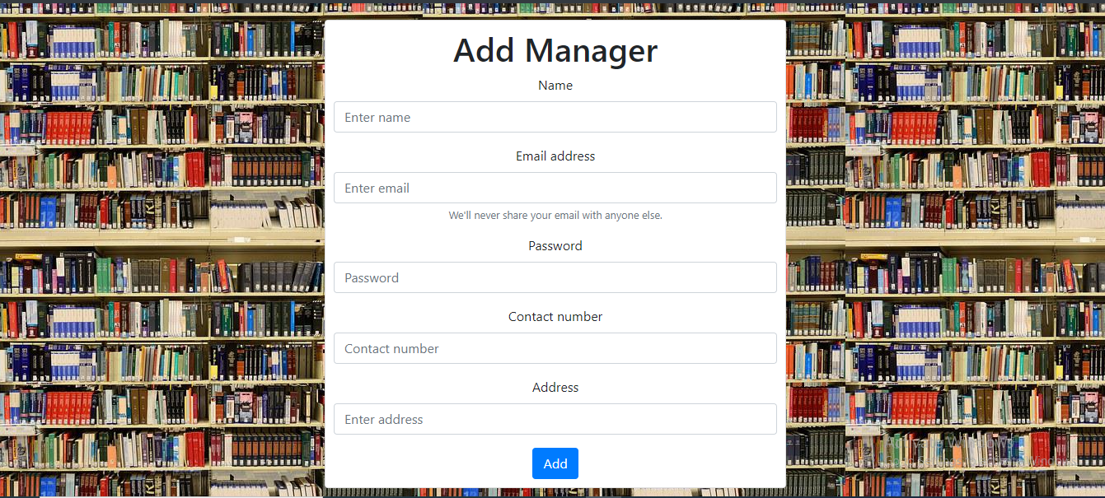
New manager form :

Slide 20
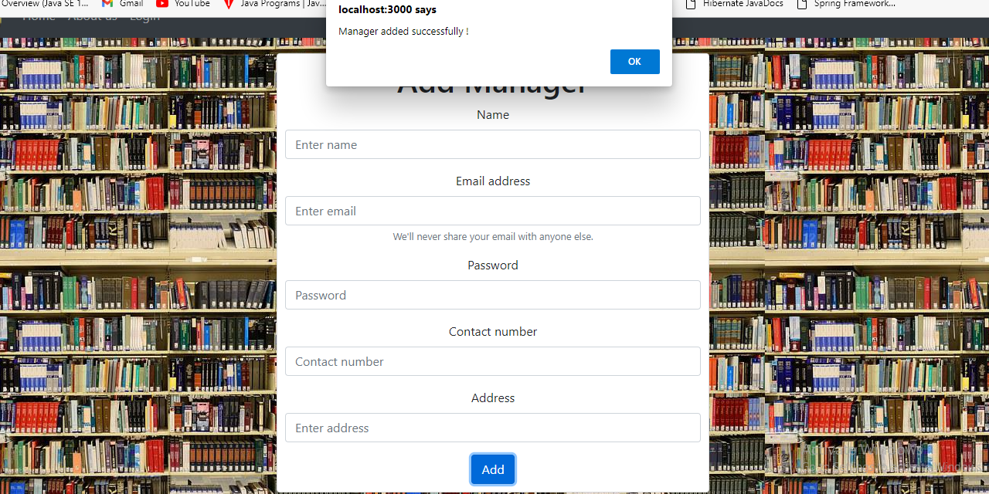
Manager added Successfully :

Slide 21
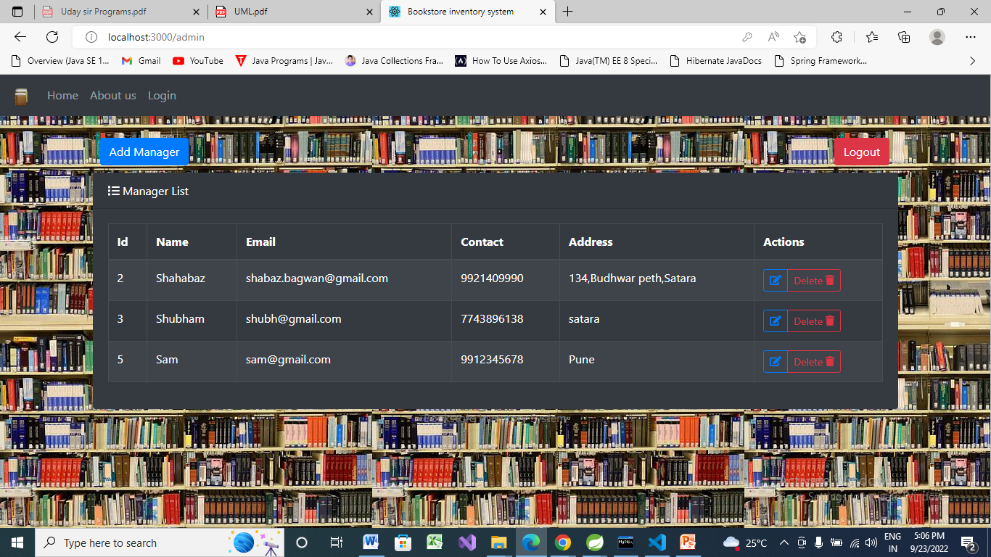
Manager List:

Slide 22
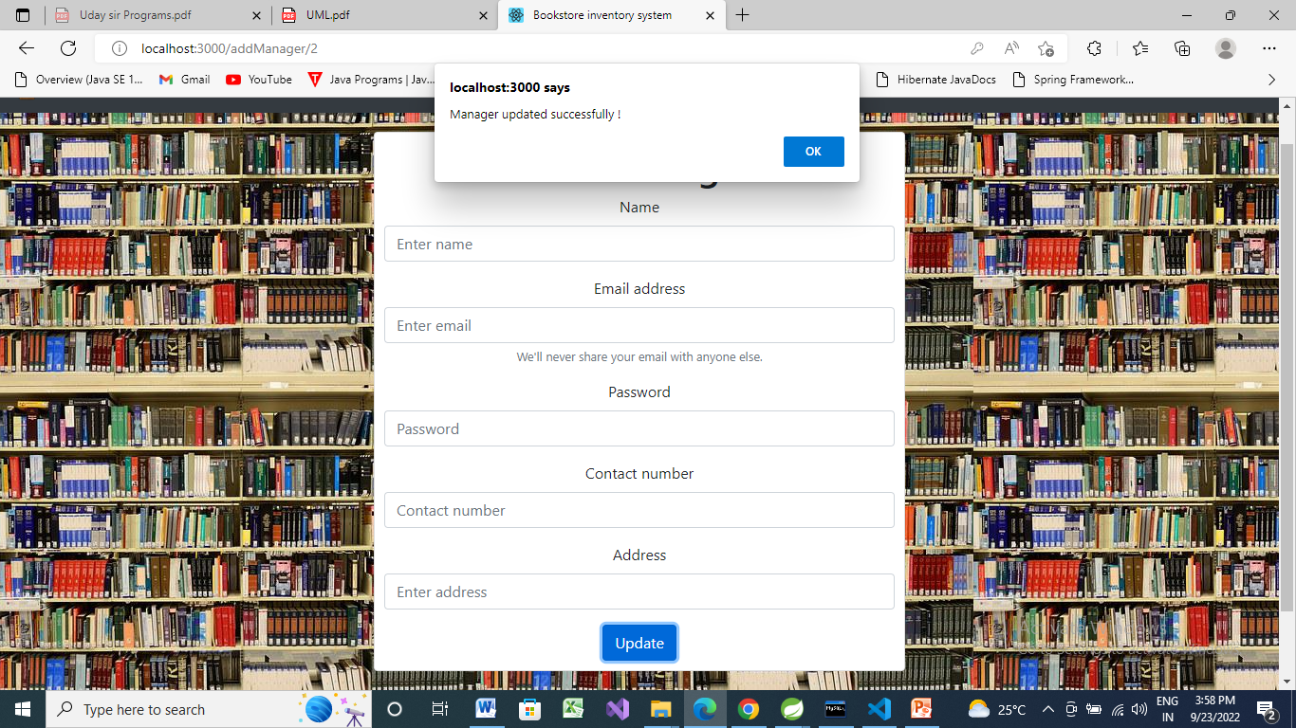
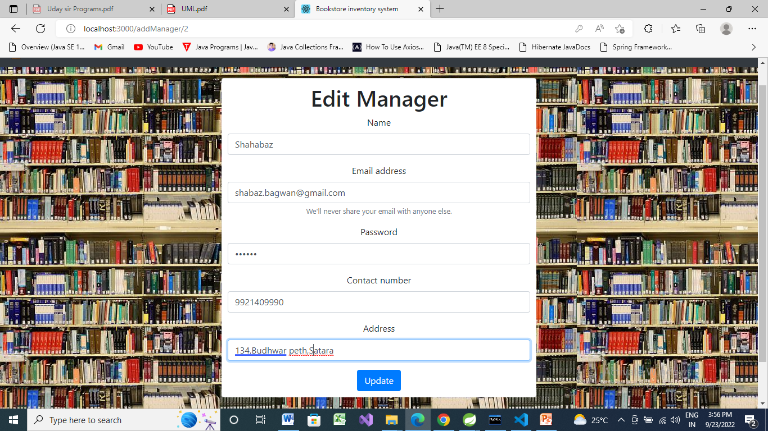

Slide 23
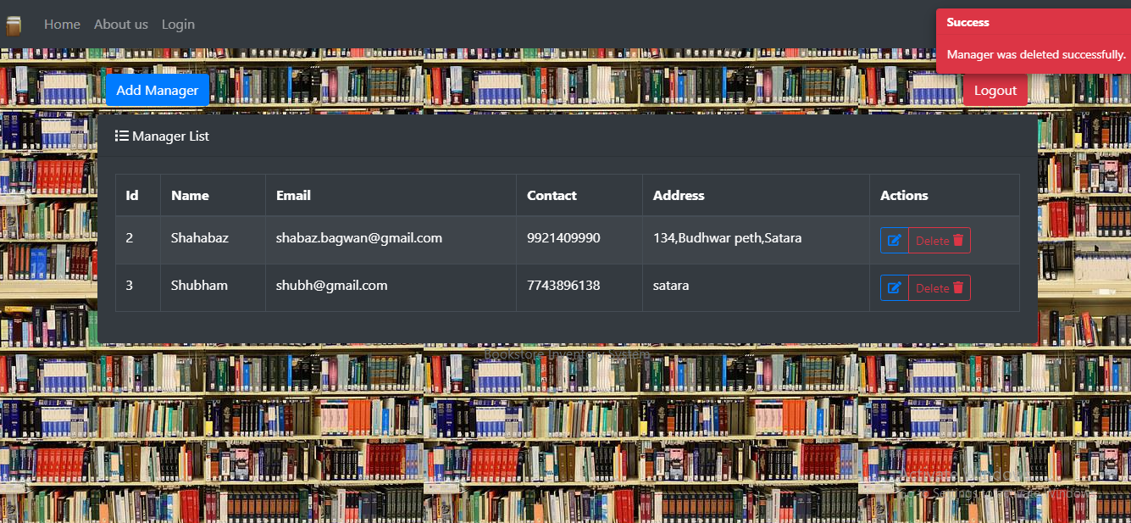
Manager Deletion :

Slide 24
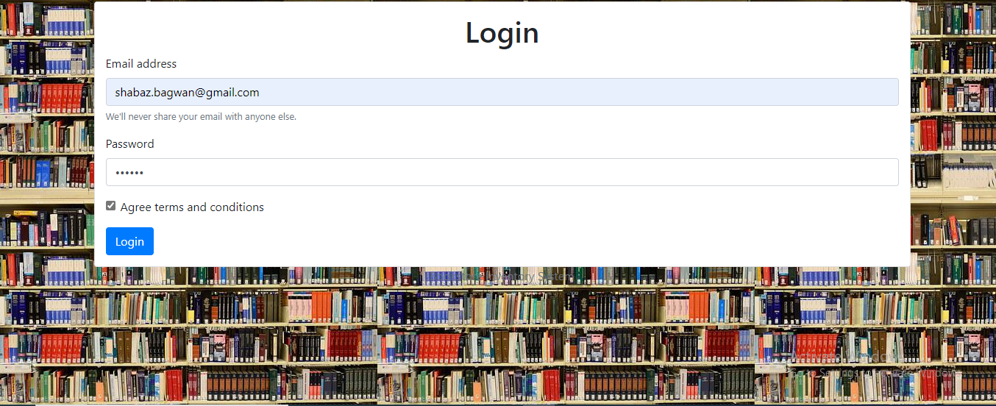
Manager Login :

Slide 25
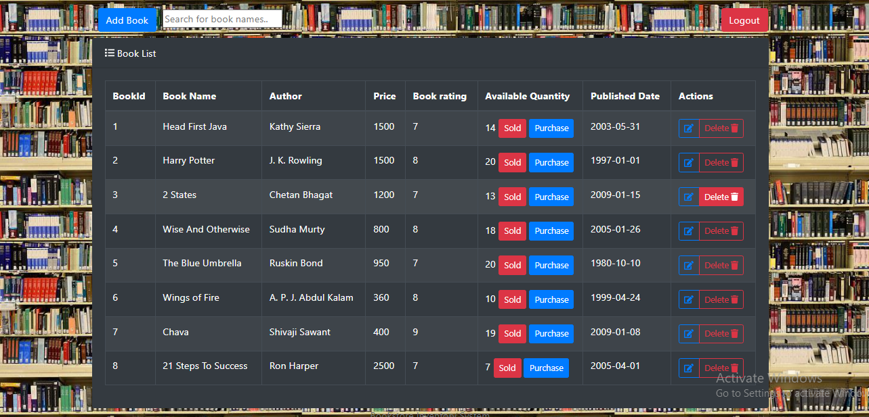
Manager Page :

Slide 26
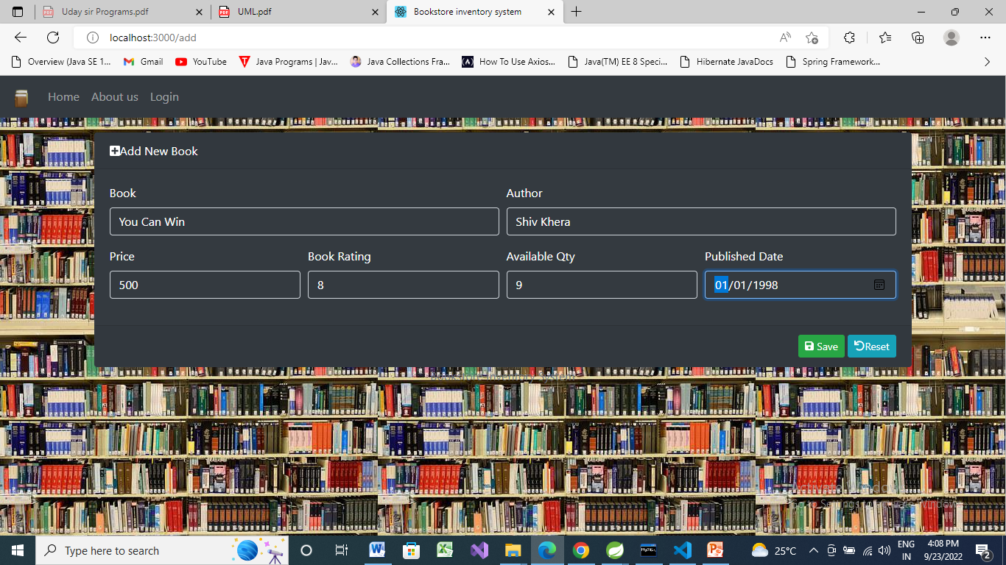
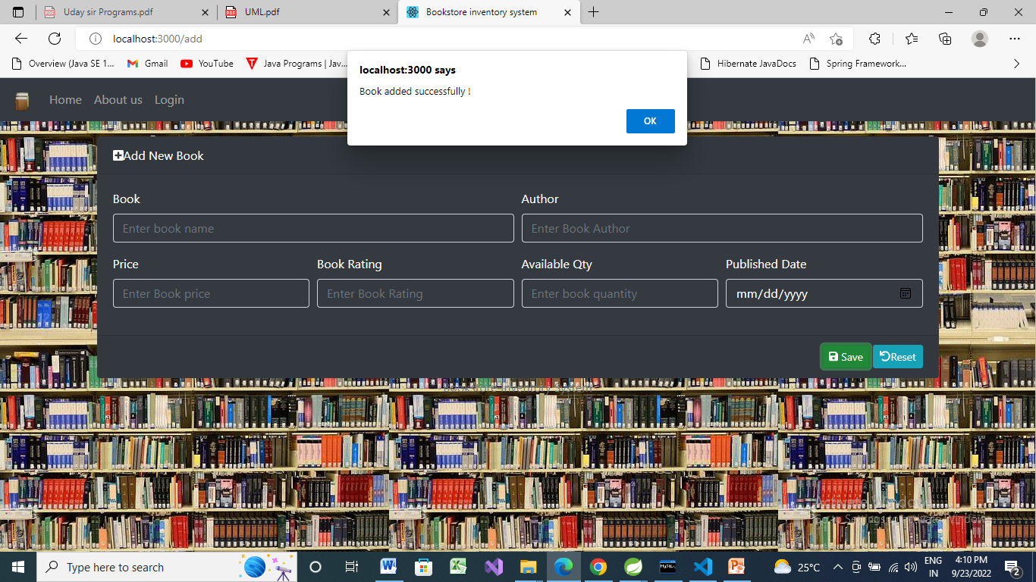

Slide 27
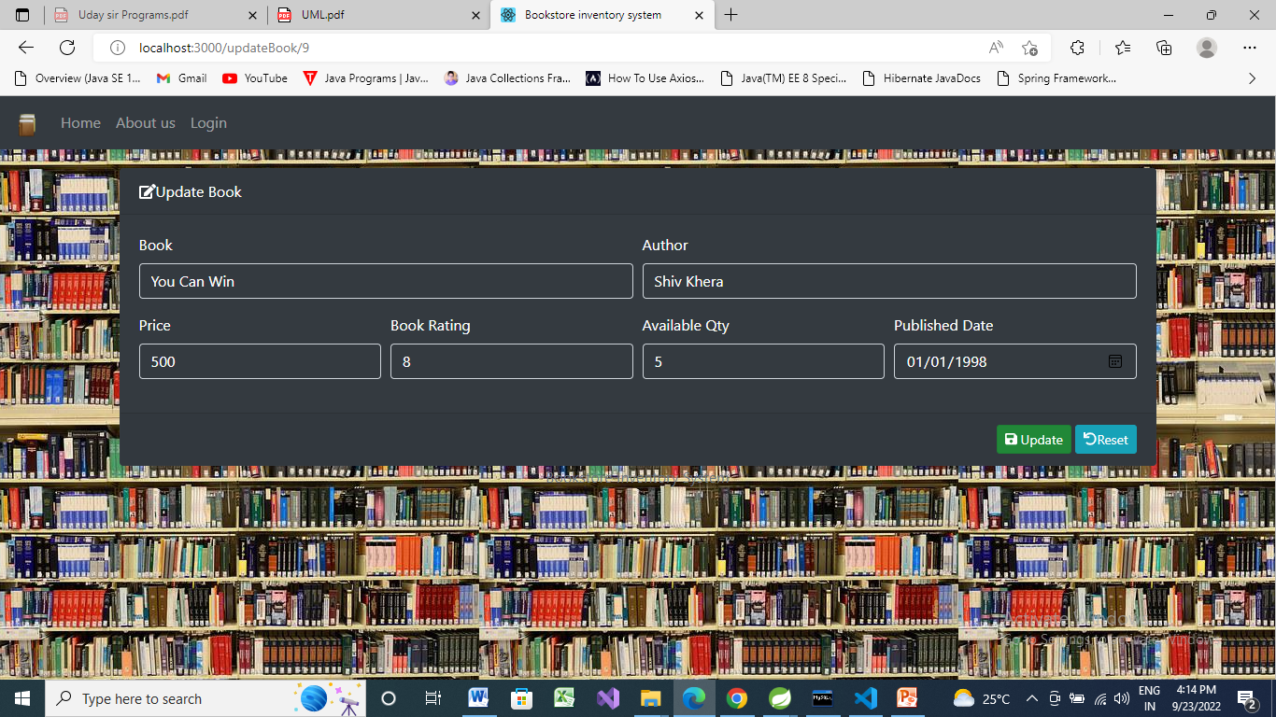


Slide 28
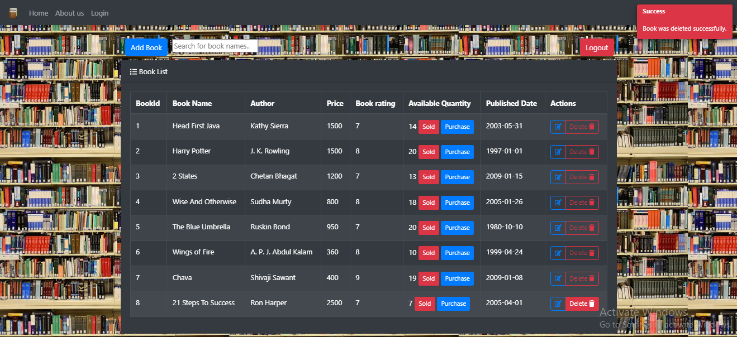
Book deletion :

Slide 29
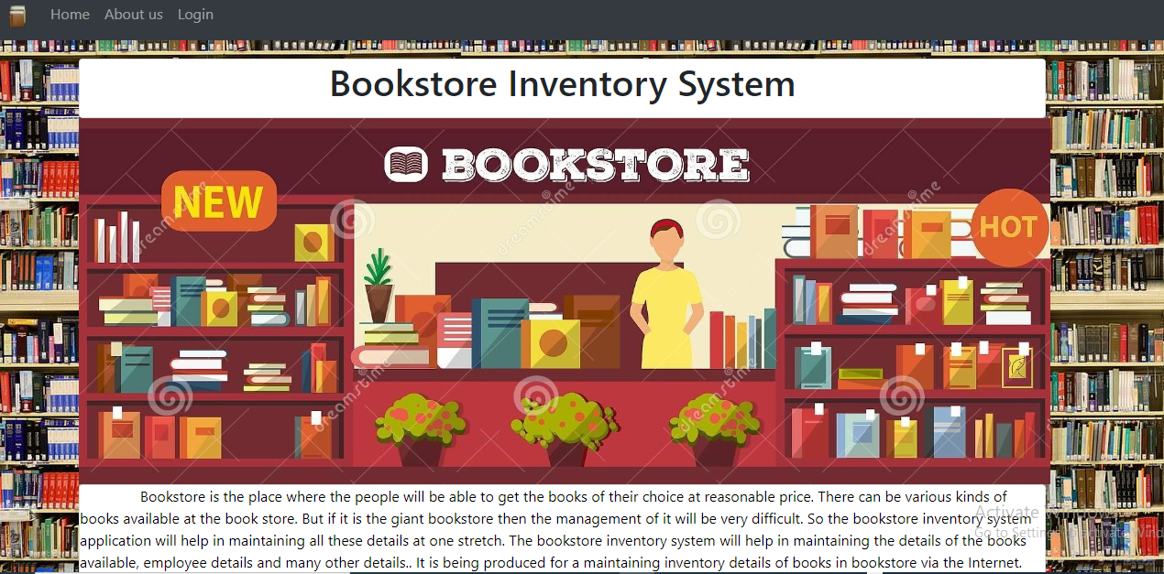
About us Page :

Slide 30
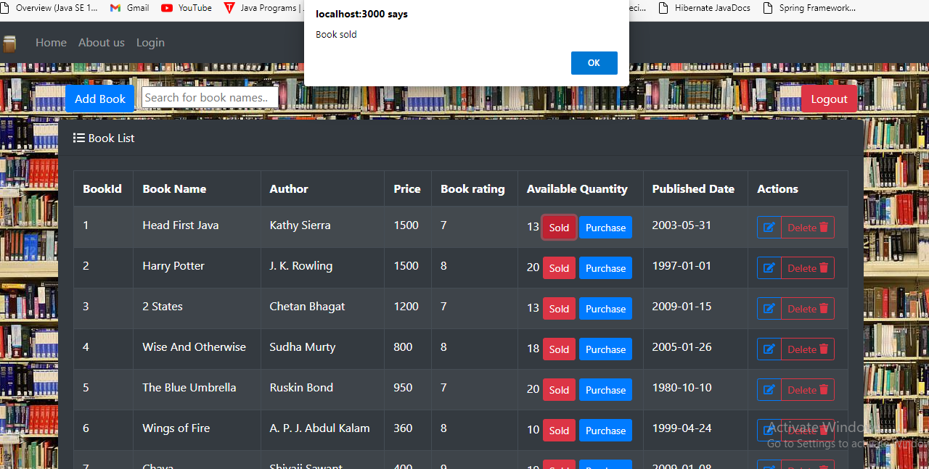
Quantity Reduced:

Slide 31
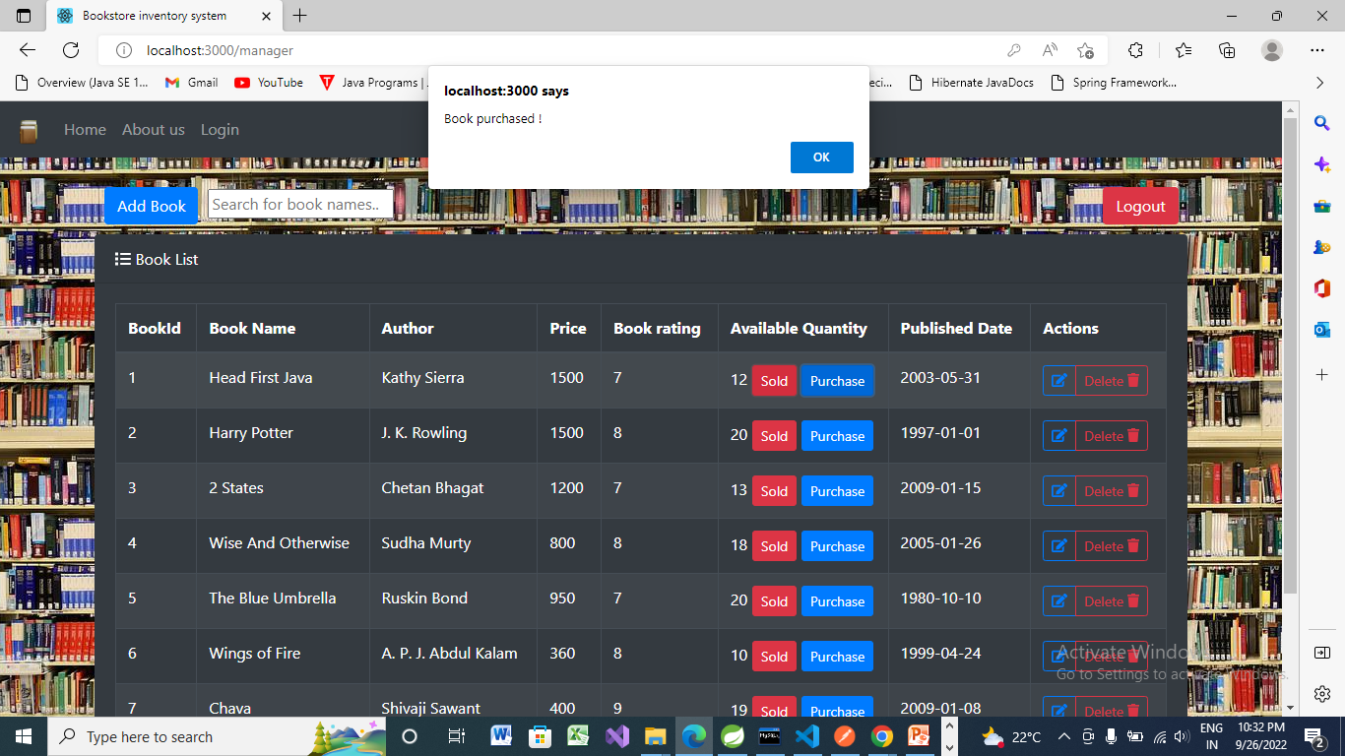
Quantity Increased:

Slide 32
After Logout :

Slide 33
Thank You

